Slide 1



A Campaign to Upgrade Bicycle subscribership
By Jasmine Albert and Callum O’Neill
- Data Scientists at Bluebikes

Slide 2
Project Brief and topics:
Introduction
Analysis
Conclusions
“To devise a scheme that encourages consumers to upgrade from purchasing a day pass/pay-as-you-go for bikes to a subscribership”

Slide 3
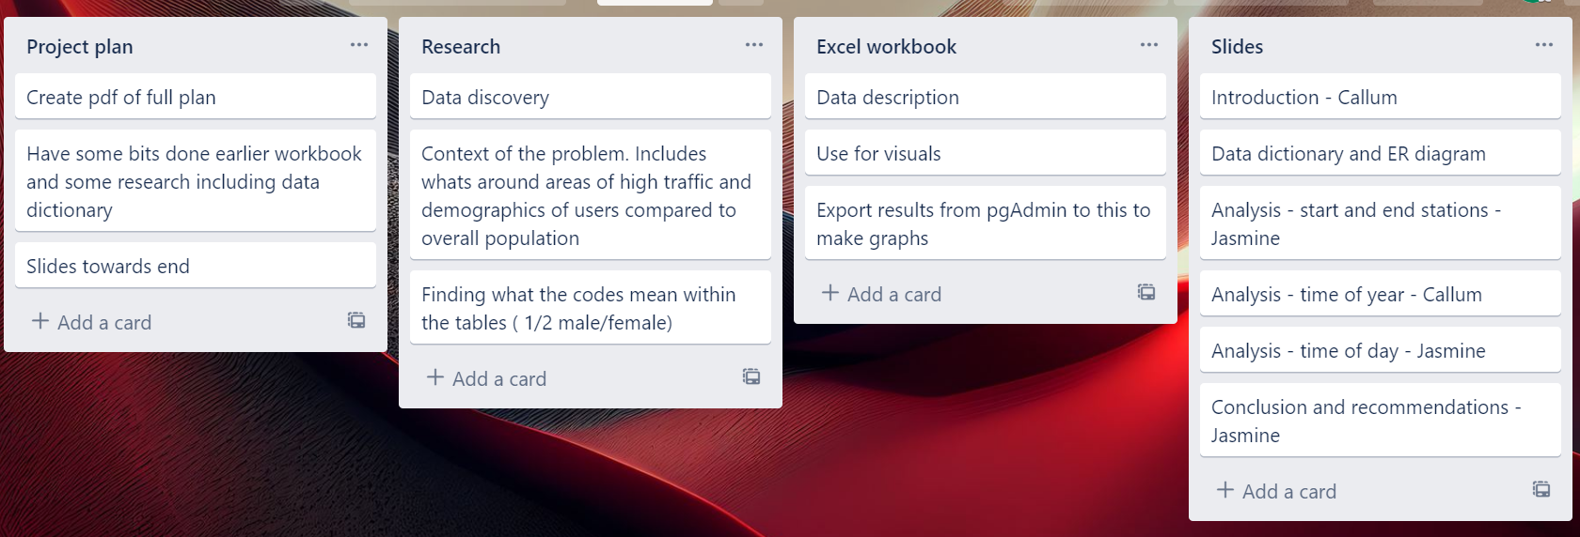
Introduction: Trello Board

Slide 4
Introduction: Data Collection Methods
Data in real time via the bluebikes app or their website. Data collected via GPS
Comprehensive trips:
Start time
End time
Start Station ID
End Station ID
Bike ID
Stations:
Number
Name
Locational data

Slide 5
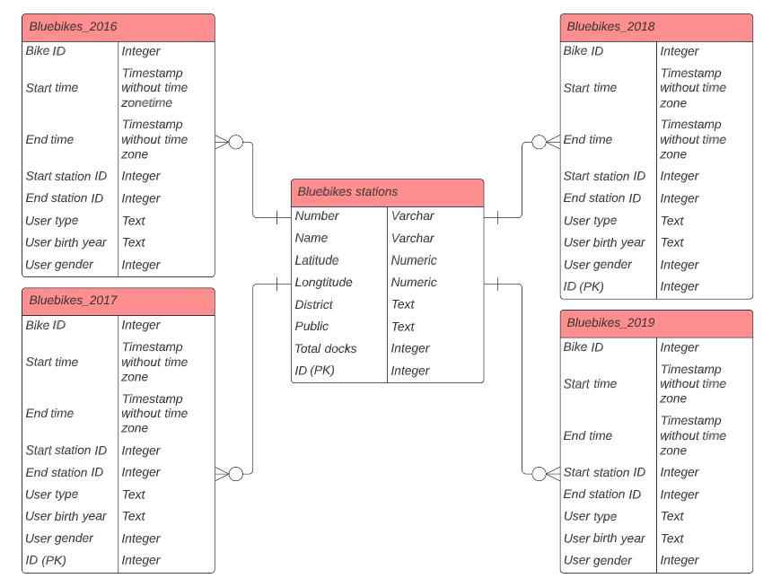
Introduction: Entity relationship diagram

Slide 6
Introduction: Data Dictionary

Slide 7
Introduction: Data Limitations + Business Assumptions
Data Limitations
Some cleaning required
Age recorded as birth Year
Subscriber and customer categories are ambiguous
Some data missing for gender and age
2016 and 2019 don’t have ID columns
Spelling mistakes in column names
Business Assumptions + Questions
Rider frequency will vary throughout the year
Am or pm?
Where is the greatest activity?

Slide 8
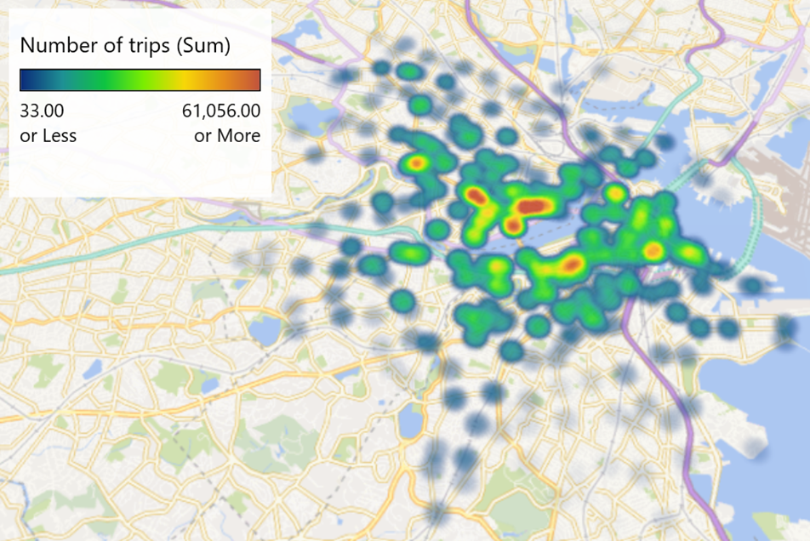
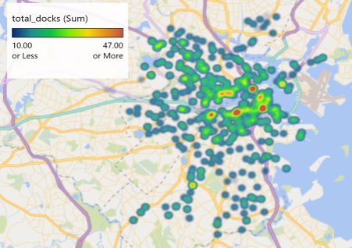
Analysis – specific stations – start
Notes:
2019 start locations and total docks per location – more just north of river – MIT and harvard – around 16000 starting and 13000 of those ending at MIT are customers, already a discount scheme in place for students – can extend this with our recommendations

Slide 9
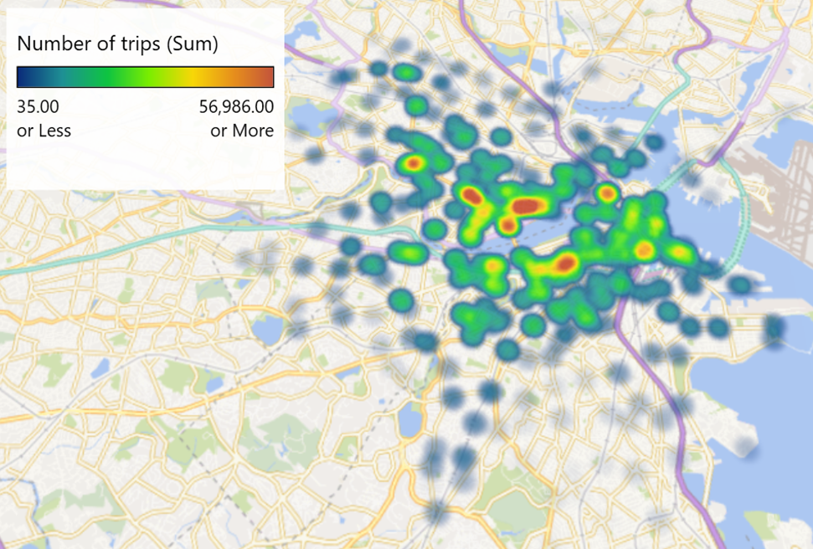

Analysis – specific stations - end
Notes:
Very similar for end locations – few more south of river than start

Slide 10
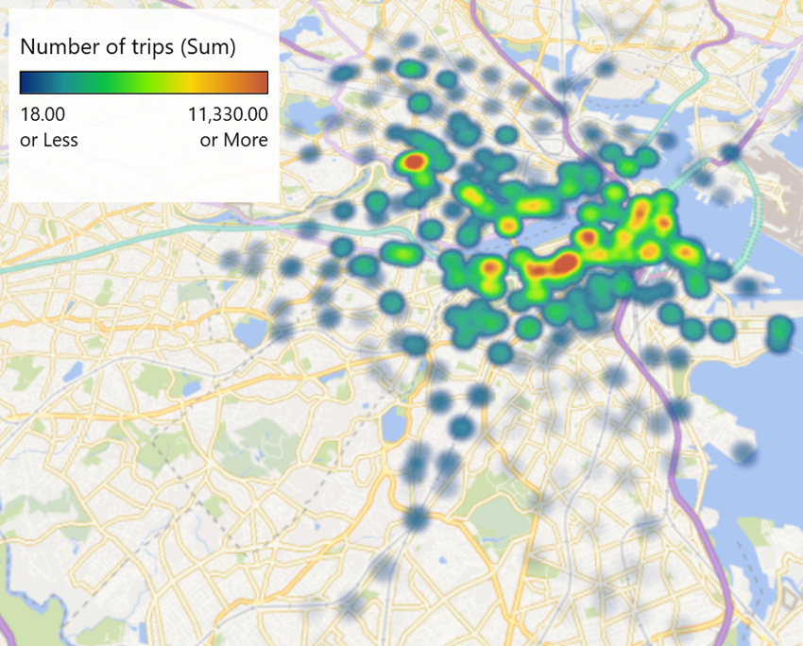
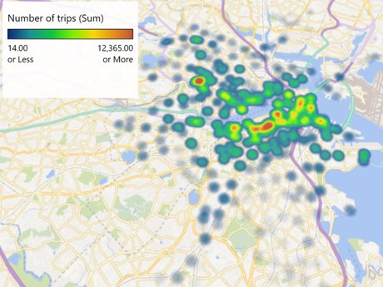
Analysis – specific stations - customer
Notes:
Specifically customers start and end – larger red in top from downtown Cambridge – tourist destination

Slide 11
Analysis – specific stations findings
Most popular stations are:
MIT at Mass Ave / Amherst St
Central Square at Mass Ave / Essex St
MIT Stata Center at Vassar St / Main St
South Station - 700 Atlantic Ave
South station – 700 Atlantic Ave has the most docks
MIT at Mass Ave/ Amherst St is joint 8th ranked by total docks

Slide 12
Analysis – time of year
Highest performing quarter:
3
Customer:
+515% from Q1 to Q2
-62% from Q3 to Q4
Subscriber:
+122% from Q1 to Q2
-36% from Q3 to Q4
Customer : subscriber
1:5 (average)

Slide 13
Analysis – time of year
Highest Total:
Subscriber – September: 281024
Customer – August: 87291
Lowest Total:
Subscriber – January: 65090
Customer – January: 4782
Greatest Increase:
APRIL
Customer: +140%
Subscriber: +50%
Peak Month to December:
Customer: -88%
Subscriber: -71%

Slide 14
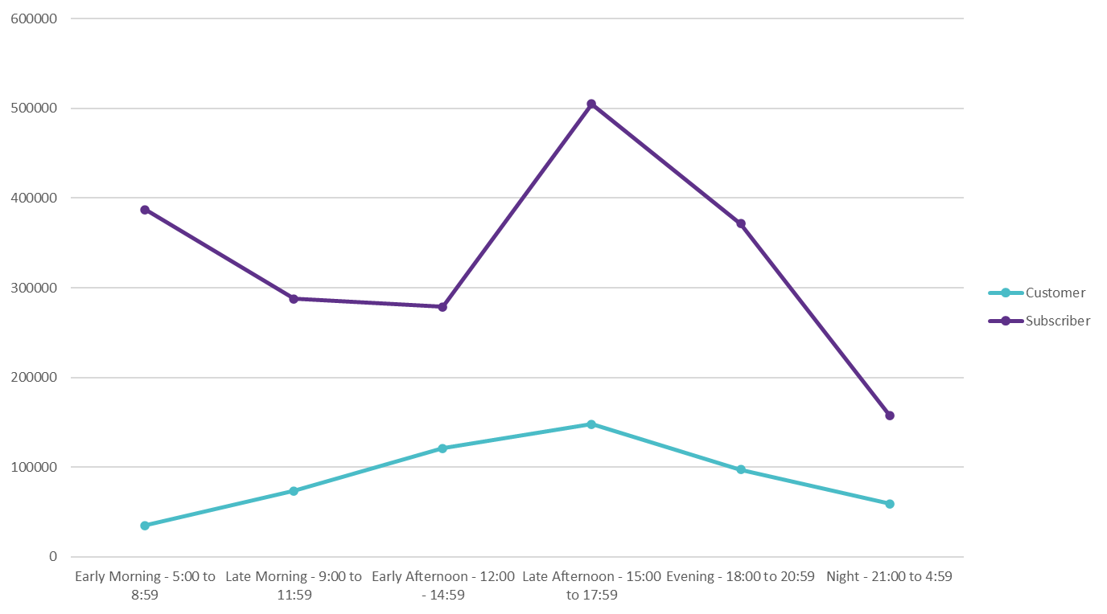
Analysis- time of day
Late afternoon is the most popular time
Notes:
Focused on 2019 as each year and the union looked the same

Slide 15
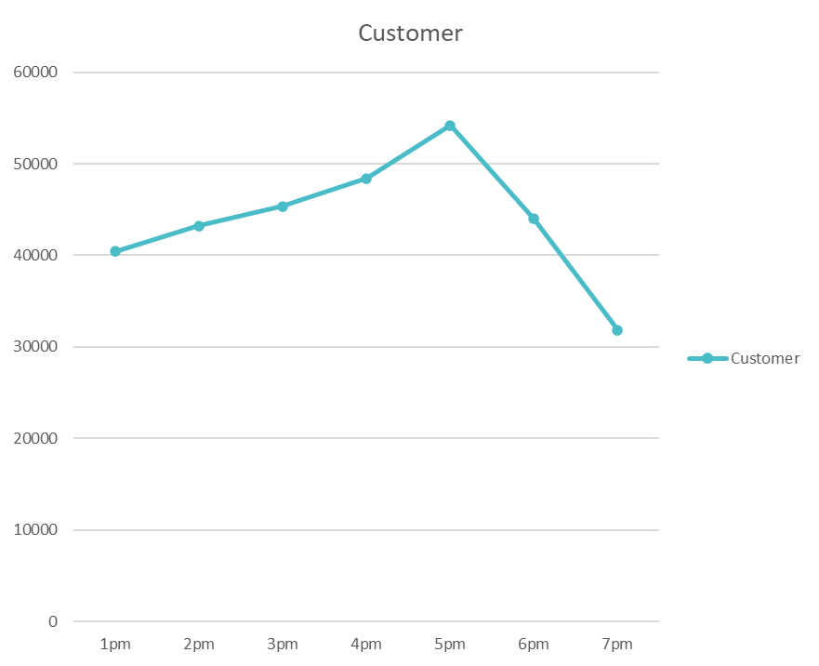
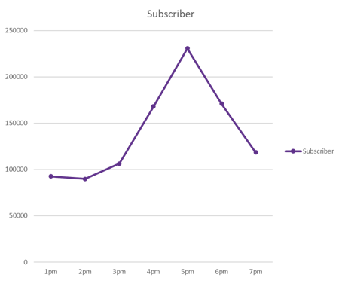
Analysis – time of day
5pm is the most popular time in the afternoon
Notes:
Same peaks for both

Slide 16
Conclusion – summary of observation
The popularity of stations is not reflected in the number of docks
The most popular times of the year are August for customers and September for subscribers
January is the least popular time of year
The most popular time of day is late afternoon (3pm-6pm), specifically from 5pm to 6pm

Slide 17
Conclusion - recommendations
More docks in the most popular stations (MIT and Harvard)
Reduced subscriber cost if choose specific location and/or time of day
Incentives for subscribing over winter including free waterproofs and hand warmers
Limited edition bikes for winter period such as modified tyres to improve traction and friction

Slide 18
Conclusions – next steps
To improve our recommendations, we could have looked at demographics of customers and subscribers

Slide 19
Recap
Introduction: Data collection, limitations, ER design
Analysis: stations, time of year, time of day within 2019.
Conclusions: overall observations, recommendations, next steps

Slide 20
References
[1]<8 weird and wonderful facts you didn’t know about cycling | ActionAid UK>
[2] <Why cycling is great for your legs, lungs, immune system and mind, plus 11 other great benefits of life on two wheels! | Cycling Weekly>
[3]<Bluebikes System Data | Blue Bikes Boston>
[4]<The best times to visit Massachusetts - Lonely Planet>
[5] <Seasons in Massachusetts: Weather and Climate (seasonsyear.com)>
[6]<8 Unforgettable Things To Do In Winter In Massachusetts (onlyinyourstate.com)>

Slide 21
Thank you for listening
Any questions?

